Slide 1

Advanced Persistent Threats
Joseph Eckl

Slide 2
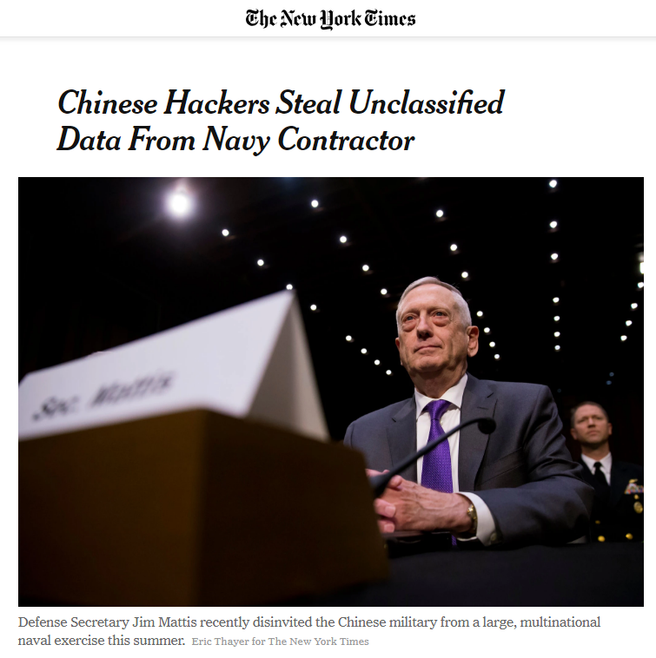
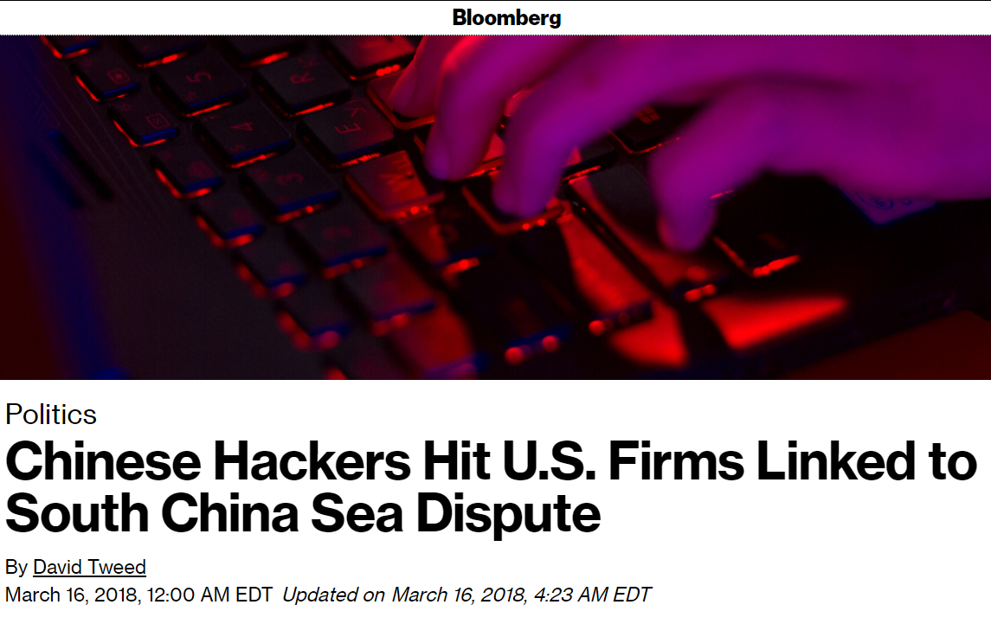
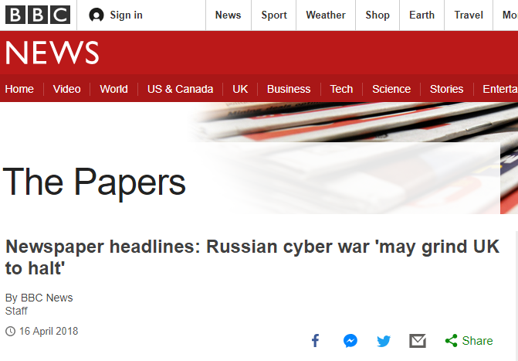

Definition
A covert, long-term attack designed to monitor or extract data
Used by organizations on a specific target for business or political purposes

Slide 3
Characteristics
Advanced
Attackers are proficient in writing malicious code, discreetly redirecting traffic, and finding and exploiting vulnerabilities
Persistent
The attack is being executed and continuously monitored by a dedicated group
Threat
The group executing the attack is organized and often has ties to a competitor or adversary of the target

Slide 4
Components
Actor – the perpetrator of the attack
Typically an agency of a government, group with connections to a competing company, or group with political motivations
Motives – the reason the attack is being executed
To gain a financial or competitive advantage or to gather intelligence
Target – the information being attacked
Intellectual property, financial information, customer information, classified information, credential access, systems access

Slide 5
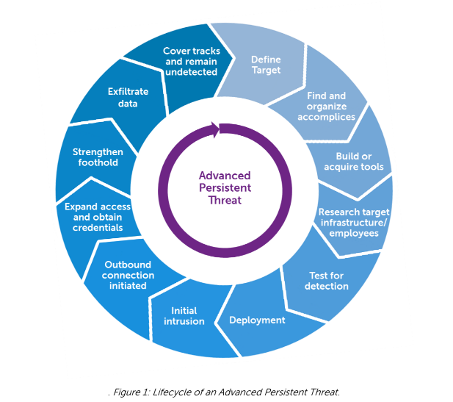
Lifecycle
Targeting
Select and research a potential target
Entry
Use entry tactics and exploit vulnerabilities to gain access
Exit
Conceal activity and exfiltrate data

Slide 6
Methods of Entry
Baiting
A type of social engineering in which infected USB drives are left laying around to be picked up by curious employees
Spear Phishing
An email from a seemingly trustworthy source that contains attachments or links to spread malicious code
The phishing attempt is exclusively targeted
Zero-Day Vulnerabilities
Brand new software vulnerabilities that have yet to be patched

Slide 7
Methods of Concealment and Exit
Rootkits
Disguise activity as another program
Pivoting
Use of a compromised system to attack other systems
Encryption
Encrypt the data being exfiltrated to reduce visibility
Port Selection
Choose the appropriate port to move encrypted data

Slide 8
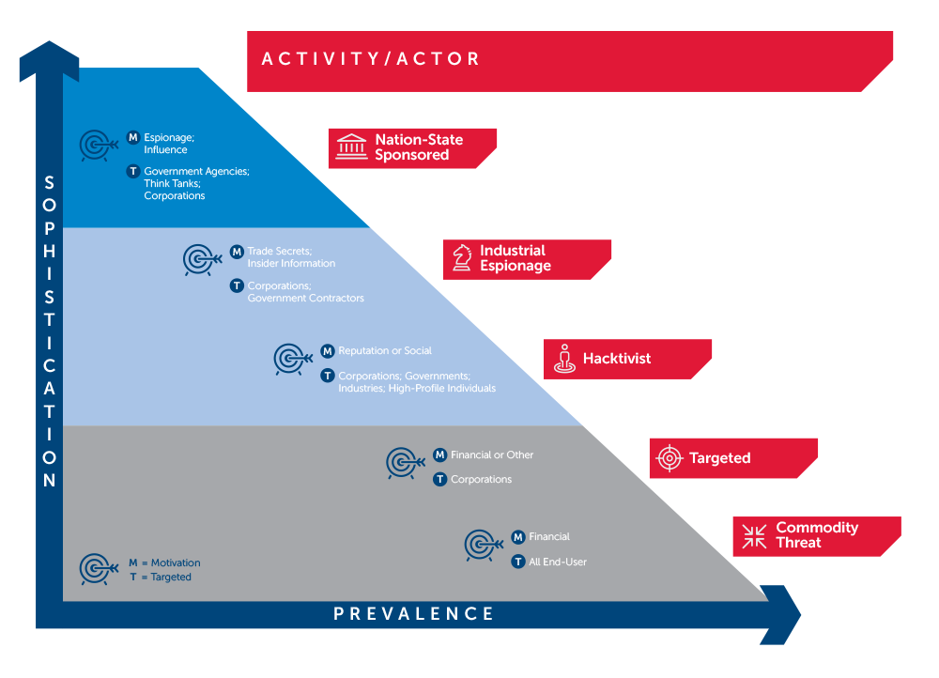
Risk Assessment

Slide 9
Prevention
Employee Training
Spot phishing emails and avoid falling for bait
Patch Maintenance
Limit potential vulnerabilities
IDPS
Network-based (broad traffic) and host-based (encryption)
Firewalls
Make use of domain whitelists
64-bit Architecture
The following cases all involve 32-bit versions of Windows

Slide 10
Advanced Persistent Threat Cases
Project Aurora (2009)
Target – Fortune 100 company data (Google, Adobe, etc)
Entry – spear phishing with links to a website that contained JavaScript that exploited an Internet Explorer vulnerability
Concealment – Use of pivoting to reach unprotected software configuration management systems
Exit – exfiltrated data to servers with innocuous-sounding domain names
Connection – Chinese universities with close ties to a Chinese competitor to Google

Slide 11
Advanced Persistent Threat Cases
RSA Breach (2011)
Target – RSA (information security company
Entry – spear phishing with Excel spreadsheet containing a zero-day Adobe Flash vulnerability
Concealment – Installation of Poison Ivy rootkit to establish connection through TCP port 3460
Exit – exfiltrated data to servers with FTP transfer of compressed and password protected RAR files
Connection – mysterious “PRC”

Slide 12
Advanced Persistent Threat Cases
Stuxnet (2009)
Target – Iran nuclear program Industrial Control Systems and Programmable Logic controllers
Entry – baiting with infected USB drives containing software exploiting Windows zero-day vulnerabilities
Concealment – Use of rootkit to disguise activity as “acceptable” to monitoring
Completion – encrypted sabotage payload
Connection – United States and Israel governments

Slide 13
Advanced Persistent Threat Cases
Duqu (2011)
Target – Industrial Control Systems
Entry – Microsoft Word files with zero-day True Type font parsing vulnerability
Concealment – rootkit and JPEG steganography
Exit – encrypted TCP protocol
Connection – international servers, unknown group

Slide 14
Advanced Persistent Threat Cases
Red October (2007-2012)
Target – diplomatic, government, and scientific institutions
Entry – Microsoft Word and Excel files with Office vulnerability
Concealment – small activity footprint, hiding as a plug-in to Adobe Reader and Office
Exit – XOR encrypted packets
Connection – Eastern Europe and Central Asia

Slide 15
Questions

